Slide 1
REST og JSON
Med Calle og Gaute

Slide 2
AGENDA
Intro til REST og JSON (20 minutter)
Hvordan implementere REST-tjenester på serversiden (30 minutter)
Hands-on: konsumering av REST-tjenester (40 minutter)
Oppsummering

Slide 3
What is JSON
JavaScript Object Notation
A syntax for storing and exchanging data.
Language independent
Lighter than XML
Notes:
- JSON uses JavaScript syntax, but the JSON format is text only, just like XML.
Text can be read and used as a data format by any programming language.
JSON blir ofte brukt for å serialisere og sende data over et nettverk, først og fremst mellom en server og web-applikasjon, som et alternativ til XML.

Slide 4
JSON vs XML
Both are easy to read
Both are hierarchical
Both are platform and language independent
JSON are shorter
JSON Quicker to read/write
JSON have build in support for arrays
Notes:
Show json file in InteliJ

Slide 5
JSON syntax
Data is in name/value pairs
Data is separated by commas
Curly braces hold objects
Square brackets hold arrays
Sample:
{
person :
{
name: "calle",
age: 36,
},
color: "dark"
}
Notes:
Expand example to include array
- Show larger example (new5)
- Transactioin in MIR project

Slide 6
What is REST
Representational State Transfer
An architecture style for designing networked applications
An easier way to connect machines. (as an alternative to SOAP, CORBA and RPC)
REST is not a "standard”, its more a like a design guideline
Most common over the HTTP protocol

Slide 7
Designing distributed applications
Client server
Hetrogeneous Interoperability ()
Stateless ()
Cachable
Notes:
Hetrogeneous: Independent of platform and programming language
Stateless: each request carries with it (transfers) all the information (state) that the server needs in order to complete it.
- each request carries with it (transfers) all the information (state) that the server needs in order to complete it.
Cache: Resources should be cachable whenever possible (with an expiration date/time). The protocol must allow the server to explicitly specify which resources may be cached, and for how long.
HTTP cache-control headers are used for this purpose.

Slide 8
RESTful application over HTTP
HTTP requests to do CRUD operations
Build in HTTP methods
Build in response codes
REST itself has no build in security features
Authentication is often done via username/password tokens (http header)
Encryption is done over HTTPS

Slide 9
CRUD
Use POST for creating new resources on the server
Use PUT for updating or change the state for a resource on the server
Use GET for getting a resource, or a list of resources
Use DELETE for deleting resources

Slide 10
REST vs SOAP
Much lighter ()
Easier to parse requests/responses
Uses less bandwidth

Slide 11
Transfer format
REST is not bound to any specific format
XML or CSV
Most common is JSON
HTML should not be used (meant for human consumption, not clients)
Notes:
SOAP is tied to XML
XML type safty
CSV is compact
JSON most trivial to parse (directly supported as a javascript datastructure)
The transfer should not contain presentation data

Slide 12
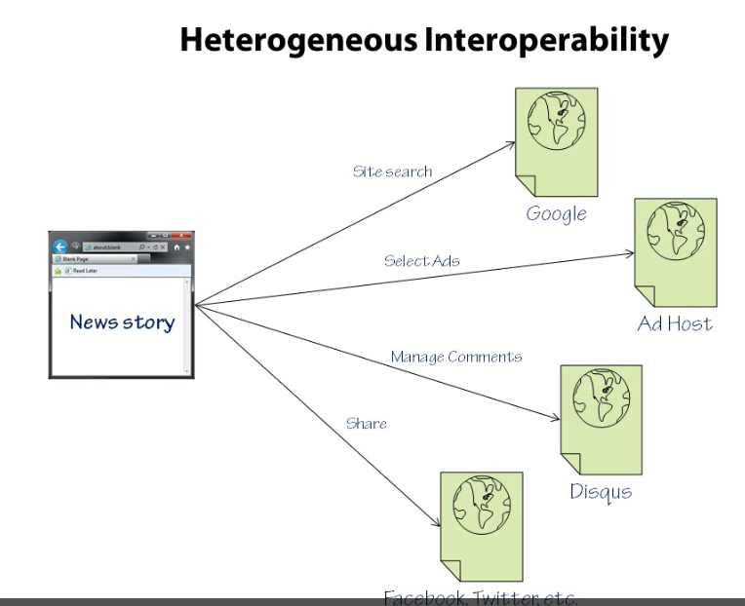

Slide 13
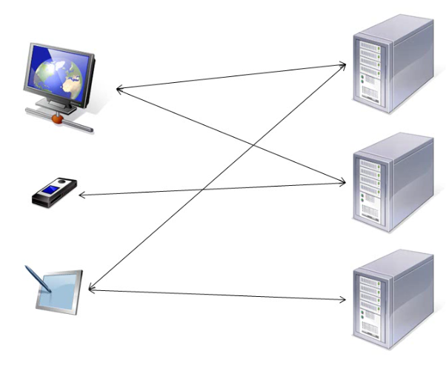

Slide 14
SOAP vs REST
SOAP
<?xml version="1.0"?>
<soap:Envelope xmlns:soap="http://www.w3.org/2001/12/soap-envelope" soap:encodingStyle="http://www.w3.org/2001/12/soap-encoding">
<soap:body pb="http://www.acme.com/phonebook">
<pb:GetUserDetails>
<pb:UserID>12345</pb:UserID>
</pb:GetUserDetails>
</soap:Body>
</soap:Envelope>
REST
http://www.acme.com/phonebook/UserDetails/12345
Notes:
Note how the URL's "method" part is not called "GetUserDetails", but simply "UserDetails". It is a common convention in REST design to use nouns rather than verbs to denote simple resources.
Letter - postcard analogy. No, body. Less bandwidth, easier to read

Slide 15
REST på serversiden
Notes:
Note how the URL's "method" part is not called "GetUserDetails", but simply "UserDetails". It is a common convention in REST design to use nouns rather than verbs to denote simple resources.
Letter - postcard analogy. No, body. Less bandwidth, easier to read

Slide 16
Hands-on
Enkel hands-on:
Backend i Java som eksponerer noen tjenester
Javascript frontend som viser data
Prerequisistes:
Start Chrome
Installér “Advanced REST client”
Notes:
Note how the URL's "method" part is not called "GetUserDetails", but simply "UserDetails". It is a common convention in REST design to use nouns rather than verbs to denote simple resources.
Letter - postcard analogy. No, body. Less bandwidth, easier to read

Slide 17
Oppsummering
Vi har lært litt om JSON
V har lært litt om REST
Vi har prøvd det i praksis
Notes:
Note how the URL's "method" part is not called "GetUserDetails", but simply "UserDetails". It is a common convention in REST design to use nouns rather than verbs to denote simple resources.
Letter - postcard analogy. No, body. Less bandwidth, easier to read

Slide 18
Oppsummering
SPØRSMÅL?
Notes:
Note how the URL's "method" part is not called "GetUserDetails", but simply "UserDetails". It is a common convention in REST design to use nouns rather than verbs to denote simple resources.
Letter - postcard analogy. No, body. Less bandwidth, easier to read

Slide 19

Takk for oss
Notes:
Note how the URL's "method" part is not called "GetUserDetails", but simply "UserDetails". It is a common convention in REST design to use nouns rather than verbs to denote simple resources.
Letter - postcard analogy. No, body. Less bandwidth, easier to read

